Slide 1
Applying SIR model in Covid-19 data
Youngwoo Kwon

Slide 2
Abstract
SIR model
SEIR model
SEIREIR model
SERAPID model
Bayesian Method
Seasonal SIR model -> 기각
..
장단점 적어야됨
설명 적여야됨
아 인터넷만 됐어도
ARIMA model?

Slide 3

Goal
Analyze Covid-19 in the United States
Find models that can represent the Covid-19 data

Slide 4
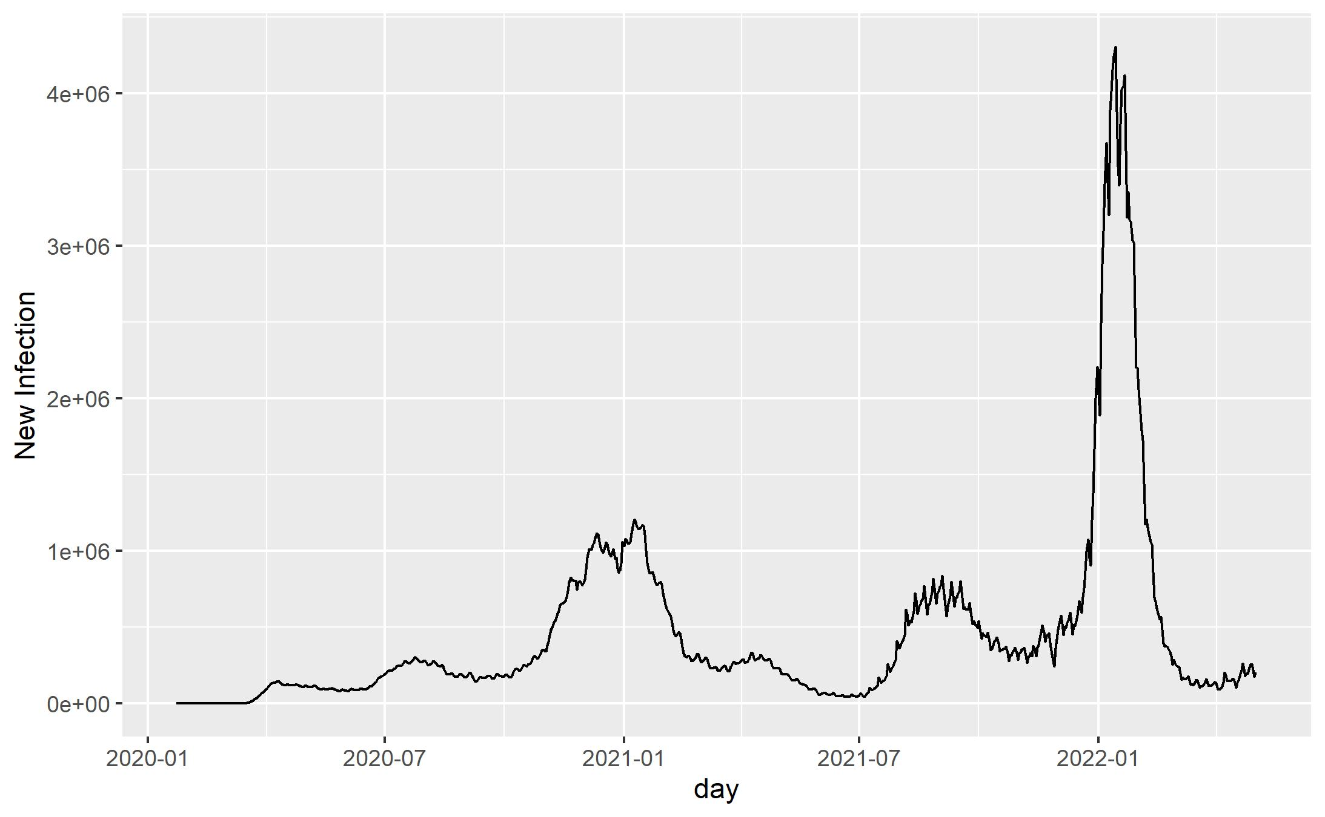
Data
Covid-19 in the United States from 2020 to 2022
Our World in Data COVID-19 repository

Slide 5
1. SIR model with Bayesian Method

Slide 6
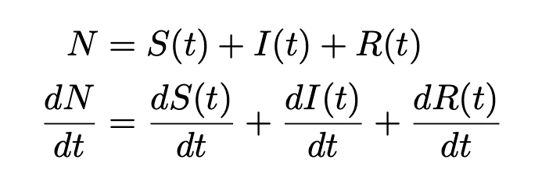
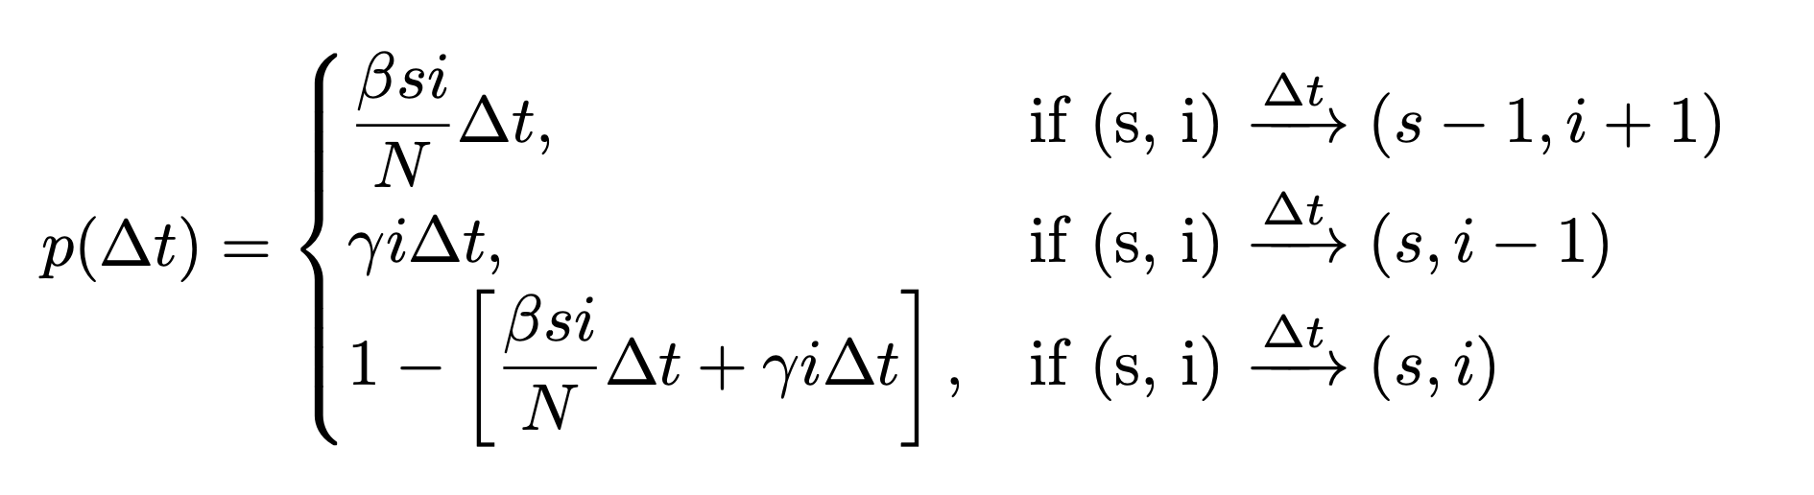
Continuous-time SIR model
The SIR model
Transition Probability
Susceptible
β
Infected
γ
Recovered

Slide 7
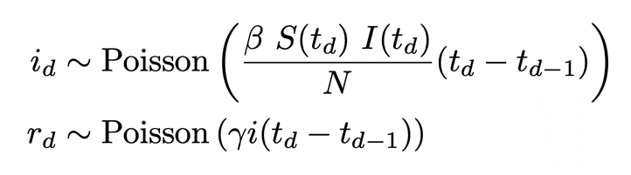
Discrete-time approximation
* To deal with real-world data, we need some discrete-time approximation

Slide 8
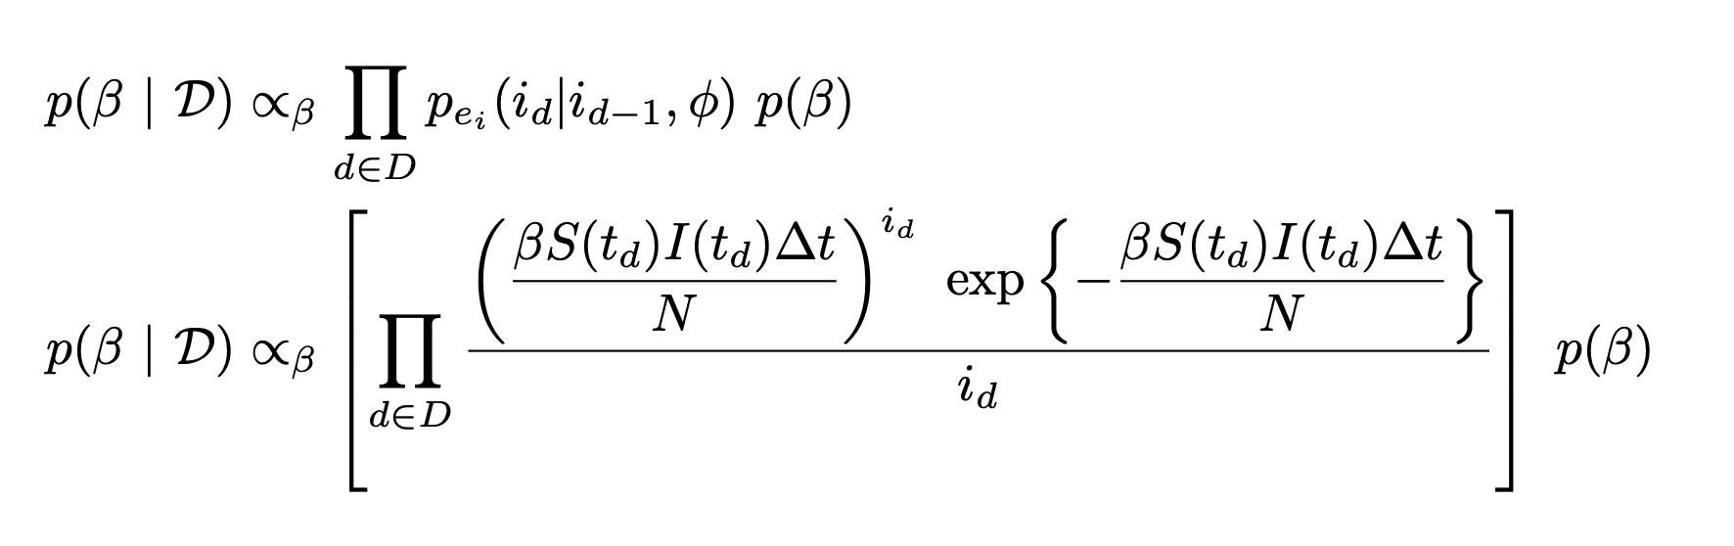
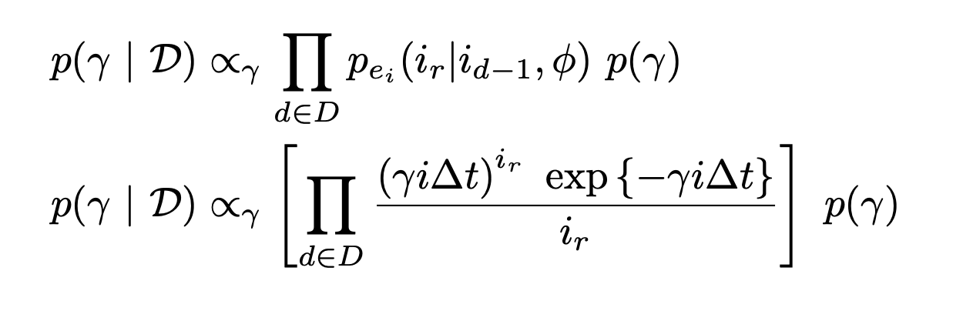
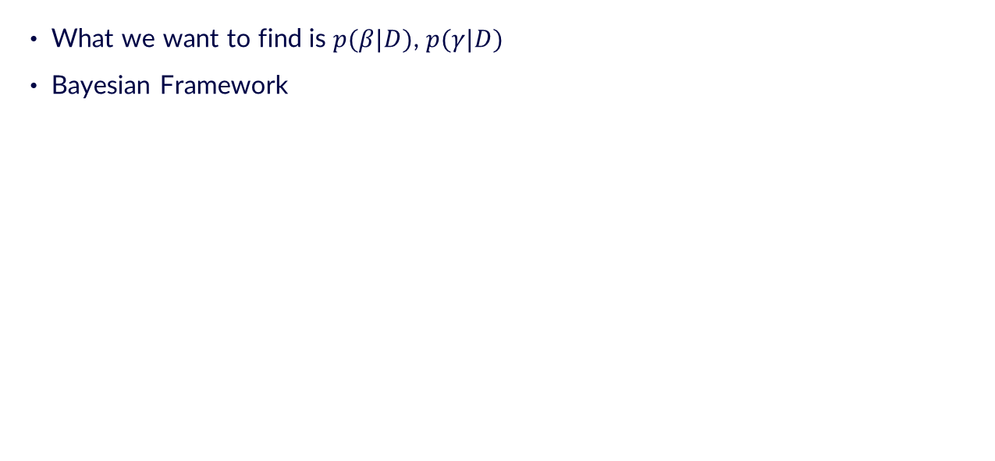
Bayesian Framework
What we want to find is $p(β|D)$, $p(γ|D)$
Bayesian Framework

Slide 9
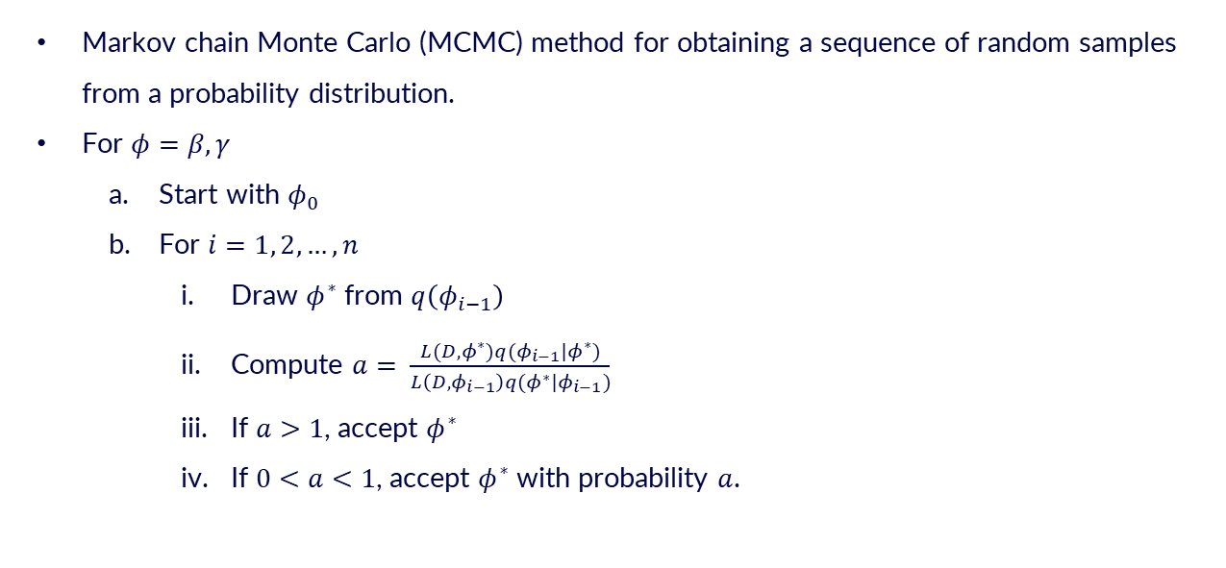
Metropolis-Hasting
Markov chain Monte Carlo (MCMC) method for obtaining a sequence of random samples from a probability distribution.
For $φ=β, γ$
Start with $φ_{0}$
For $i=1, 2, …,n$
Draw $φ^{∗}$ from $q\left(φ_{i−1}\right)$
Compute $a= \frac{L(D,φ^{∗})q(φ_{i−1}|φ^{∗})}{L\left(D,φ_{i−1}\right)q(φ^{∗}|φ_{i−1})}$
If $a>1$, accept $φ^{∗}$
If $0<a<1$, accept $φ^{∗}$ with probability $a$.

Slide 10
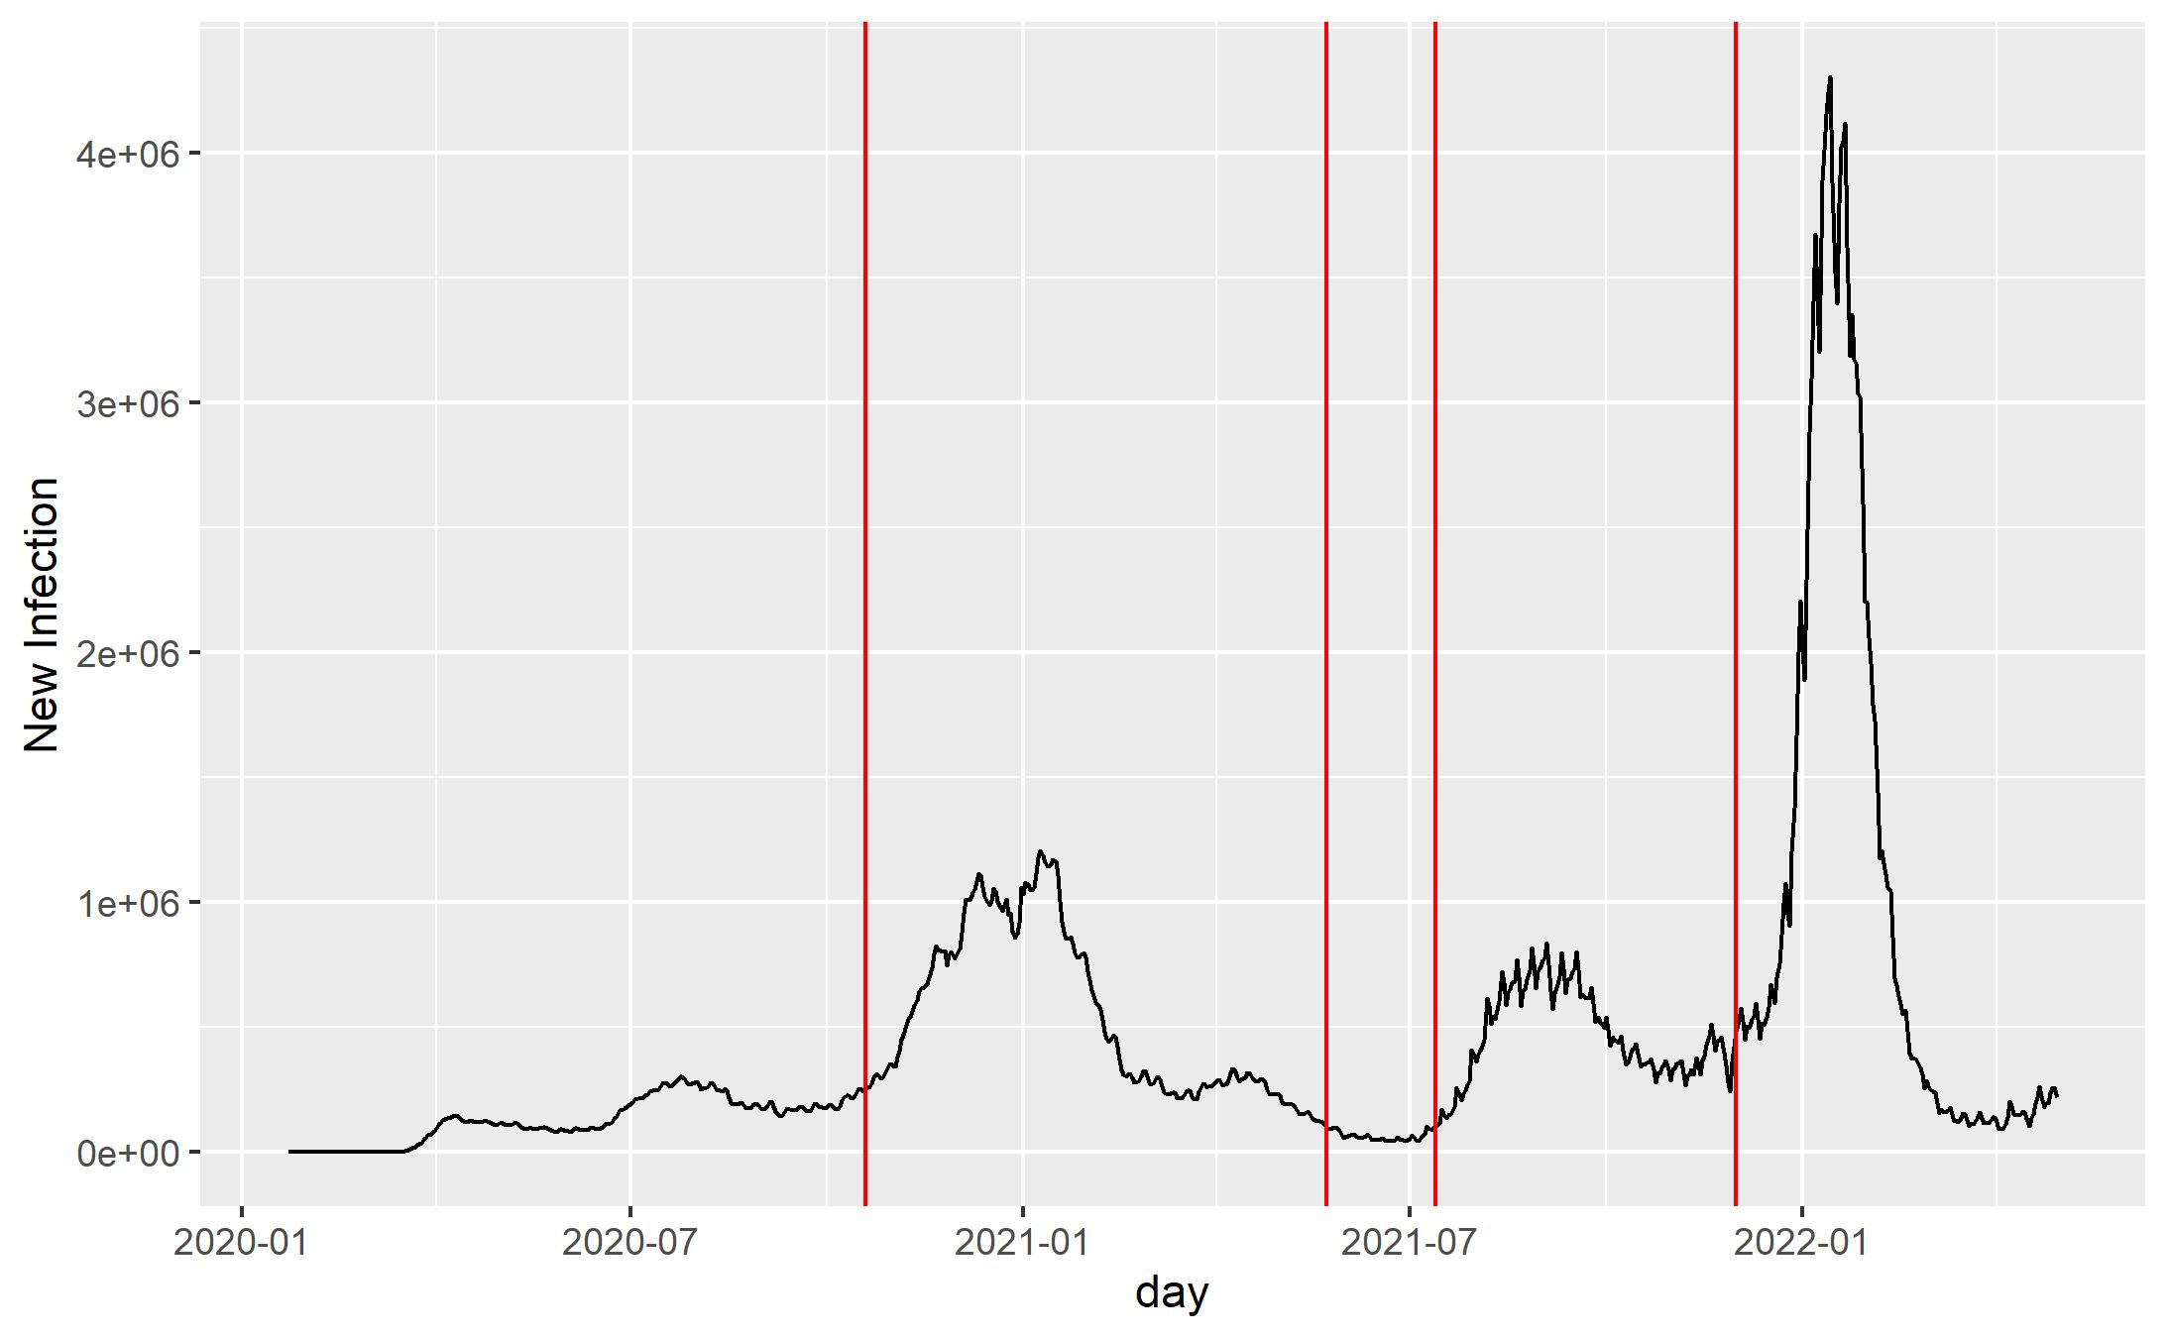
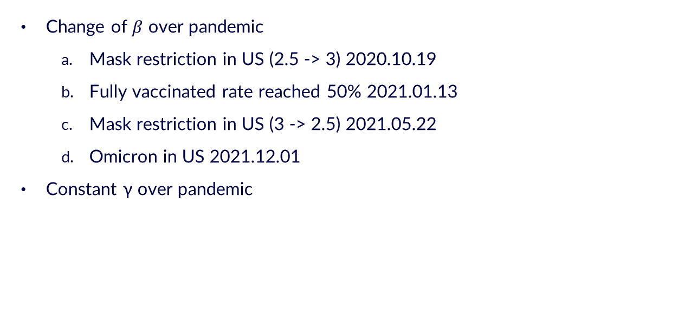
Apply to the real data
Change of $β$ over pandemic
Mask restriction in US (2.5 -> 3) 2020.10.19
Fully vaccinated rate reached 50% 2021.01.13
Mask restriction in US (3 -> 2.5) 2021.05.22
Omicron in US 2021.12.01
Constant γ over pandemic

Slide 11
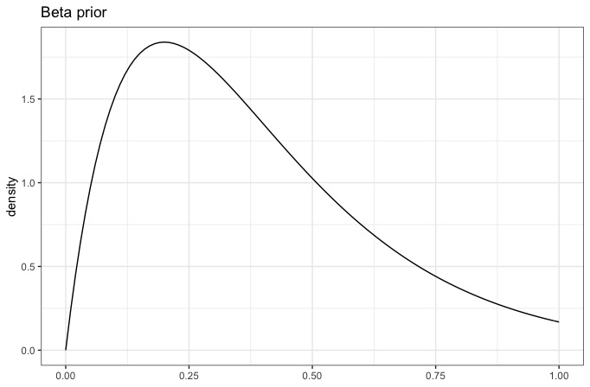
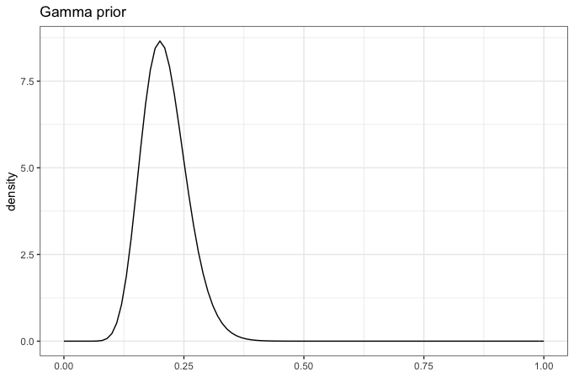
Prior distribution selection
Gamma Distribution for β and γ

Slide 12
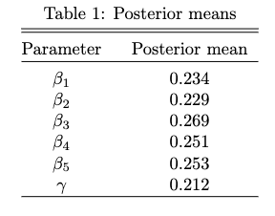
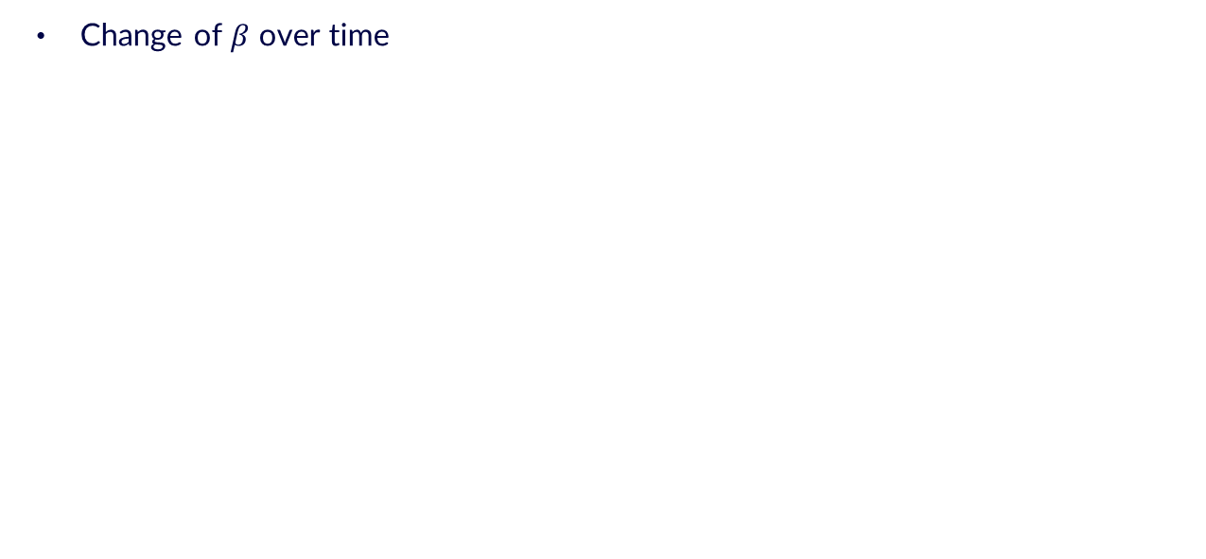
Result
Change of $β$ over time

Slide 13
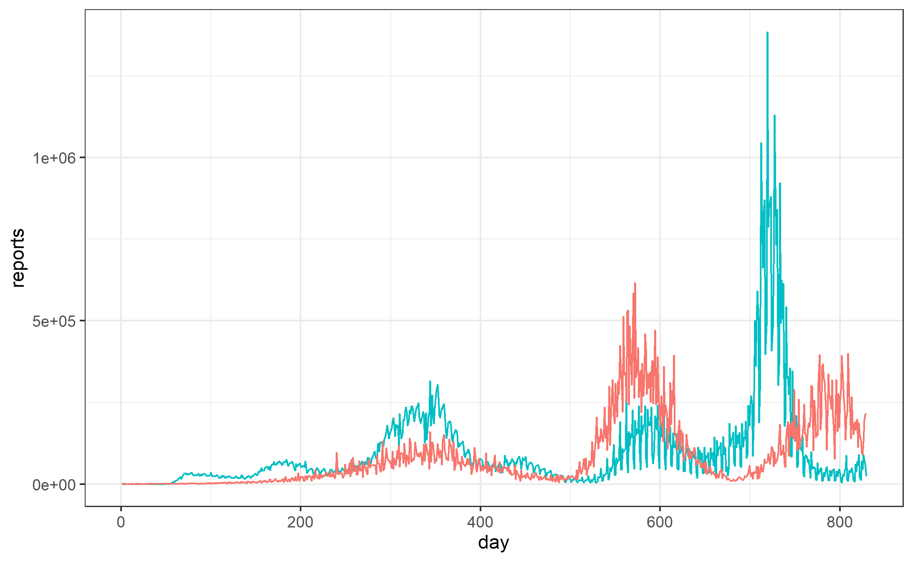
Result
Blue: real data
Red: simulation data

Slide 14
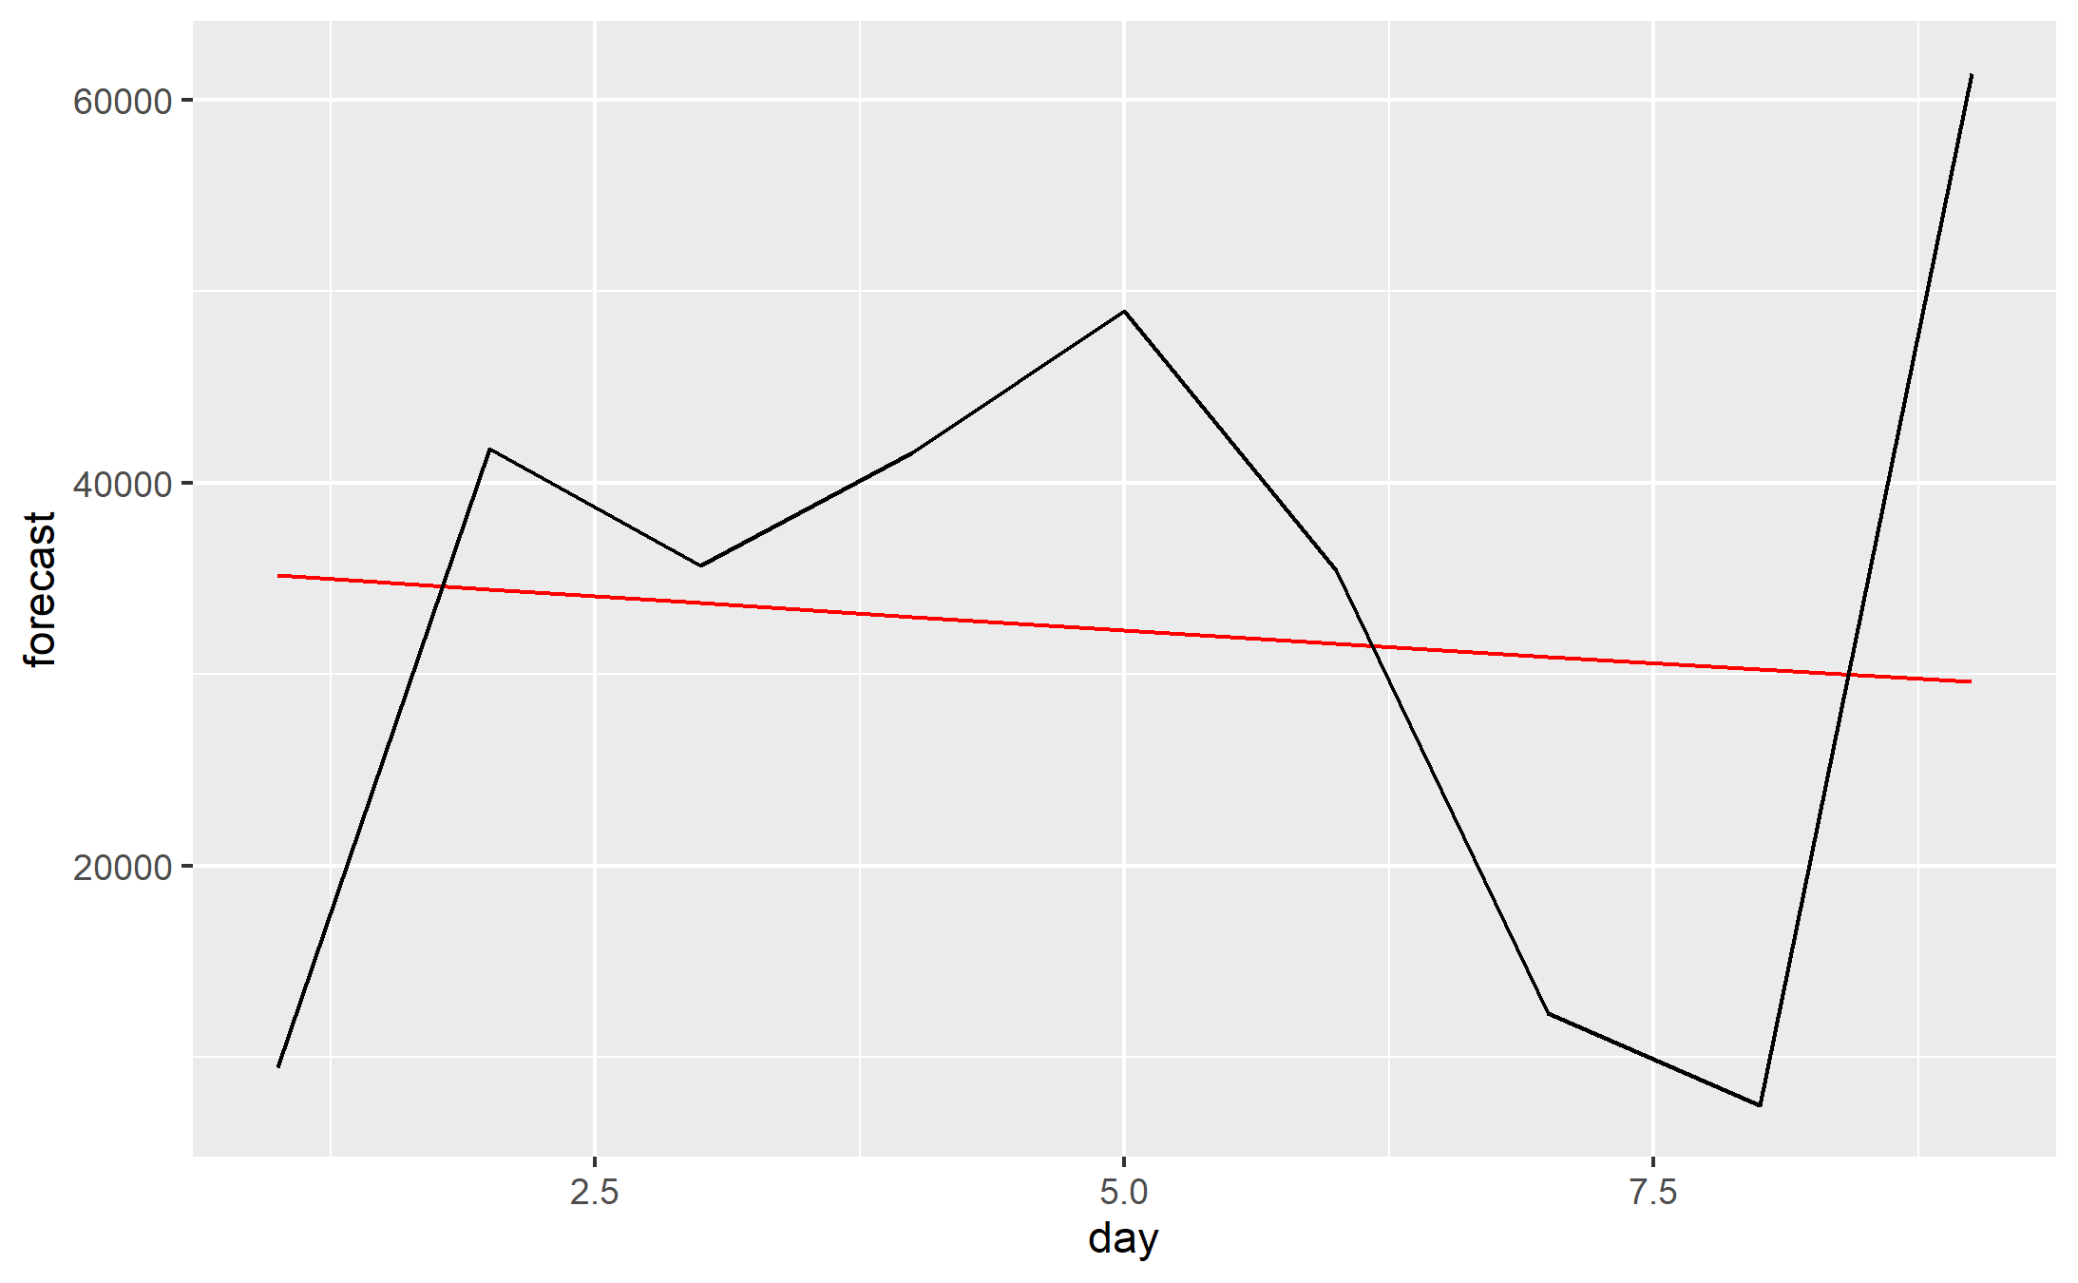
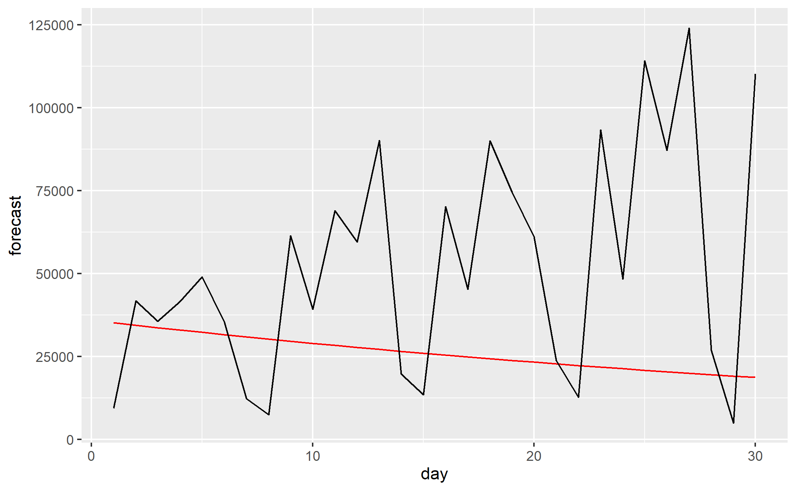
Forecasting Covid cases
9 days prediction
30 days prediction
pred | 32346.44
actual | 32680.78
pred | 26161.97
actual | 52383.63

Slide 15
Summary
Divided data into 5 parts
Short computation time
Difference between the model and actual infection
Change of β/γ/N over time
Gap between the actual infection and the S-I-R process
A person who is infected once cannot be infected again
Need a more complex model

Slide 16
2. SEIREIR model

Slide 17
SEIR model
Significant latency period during which individuals have been infected but not yet infectious.
Susceptible
β
Exposed
σ
Infected
γ
Recovered

Slide 18
SEIREIR model
Two covid19 pandemic seasons
before omicron (2021-01)
after omicron (2022-02)

Slide 19
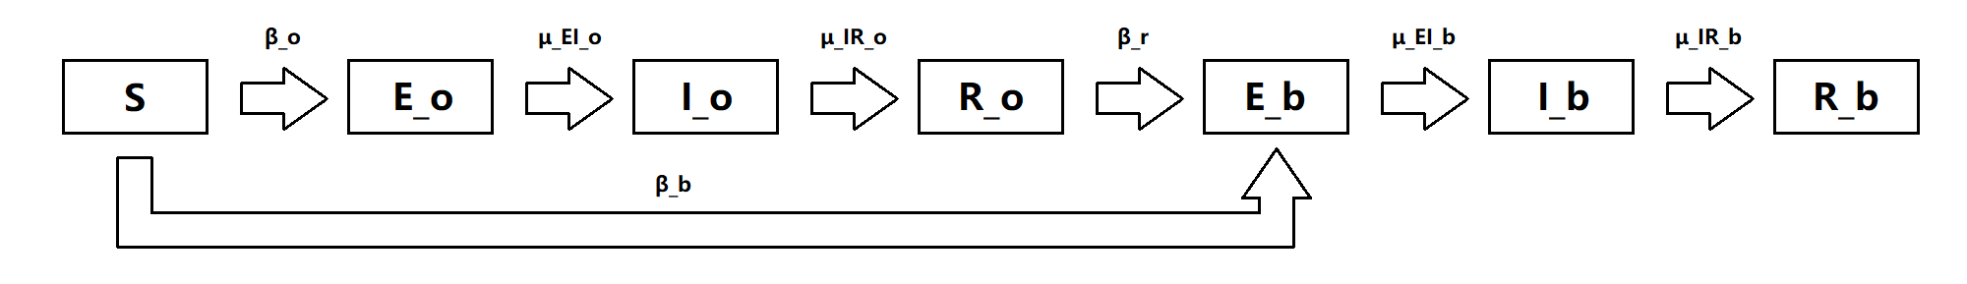
SEIREIR model
Two EIR processes in the model
E_{o}, I_{o}, R_{o} : States for Covid19 before omicron
E_{b}, I_{b}, R_{b} : States for Covid19 after omicron

Slide 20
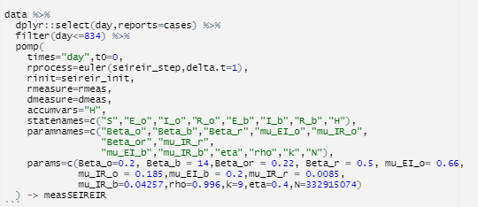
SEIR model
1) Build a model

Slide 21
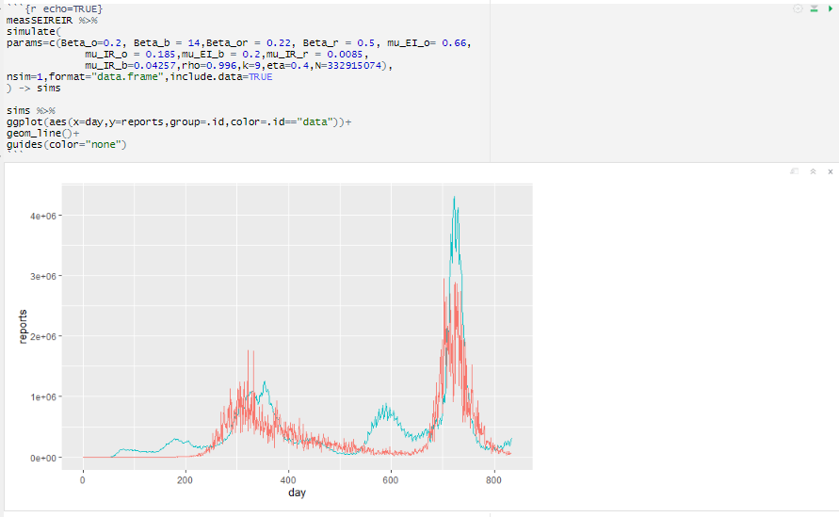
SEIR model
2) Simulate Graphs

Slide 22
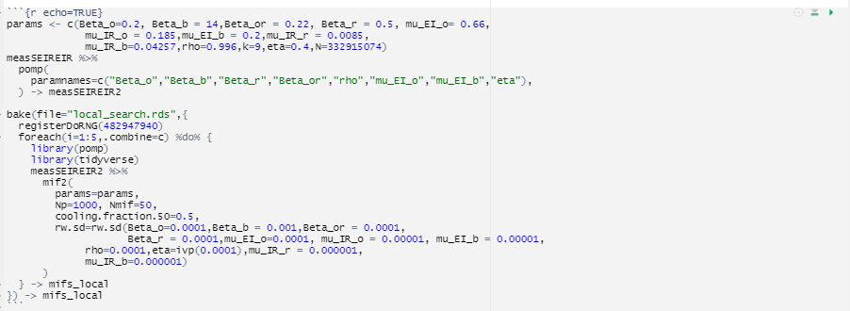
SEIR model
3) Local search

Slide 23
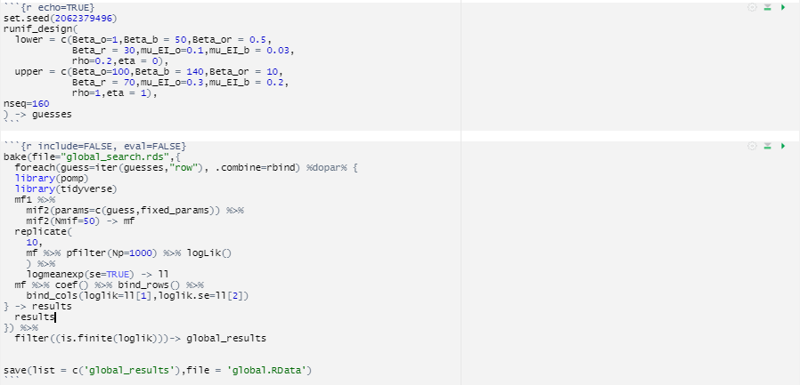
SEIR model
4) Global Search

Slide 24
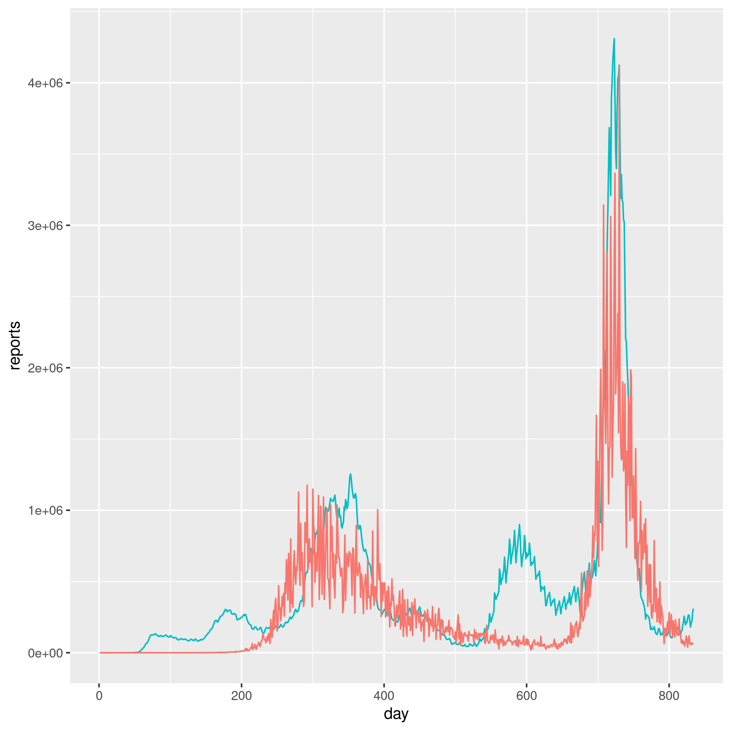
SEIREIR model
Local Search
coef. | β_{o} | β_{b} | β_{r} | μ_{EI,o} | μ_{IR,o} | μ_{EI,b}
value | 0.198 | 13.23 | 0.499 | 0.663 | 0.184 | 0.200
coef. | μ_{IR,r} | μ_{IR,b} | ρ | k | η | N
value | 0.009 | 0.042 | 0.996 | 9 | 0.400 | 3.3e8

Slide 25
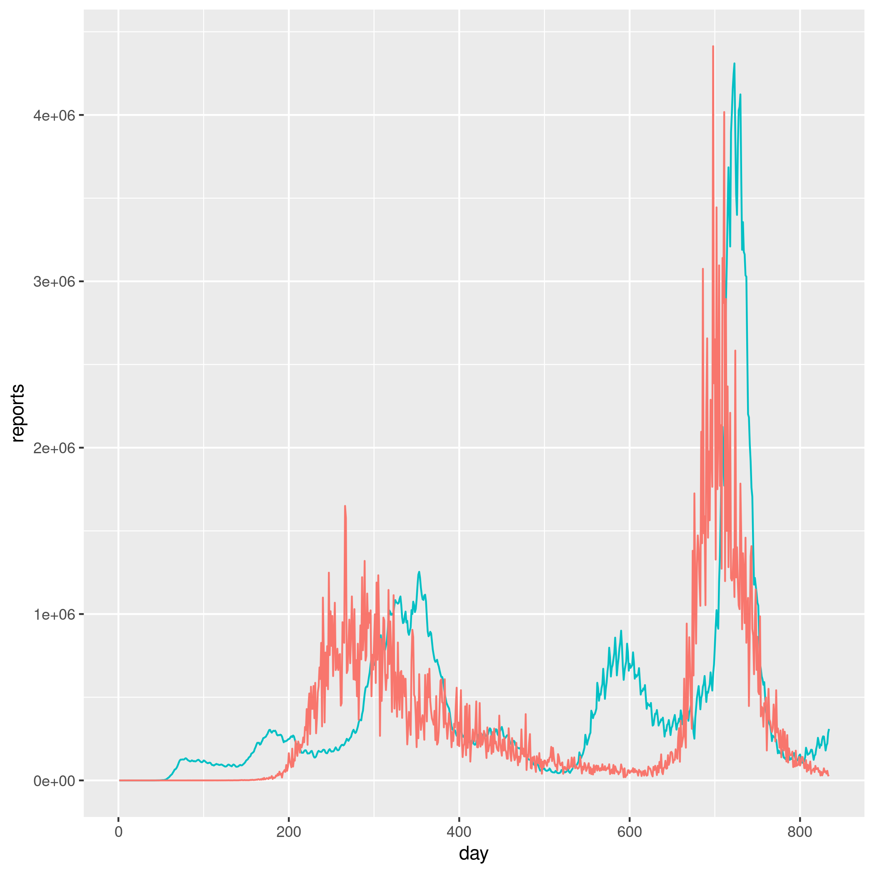
SEIREIR model
Global Search
coef. | β_{o} | β_{b} | β_{r} | μ_{EI,o} | μ_{IR,o} | μ_{EI,b}
value | 0.213 | 12.62 | 0.471 | 0.652 | 0.171 | 0.204
coef. | μ_{IR,r} | μ_{IR,b} | ρ | k | η | N
value | 0.009 | 0.040 | 0.996 | 9 | 0.446 | 3.3e8

Slide 26
Summary
Model and real data tend to match
Long computation time
There is still a gap between the SEIR model and the actual covid19 infection

Slide 27
3. SEAPIRD model

Slide 28
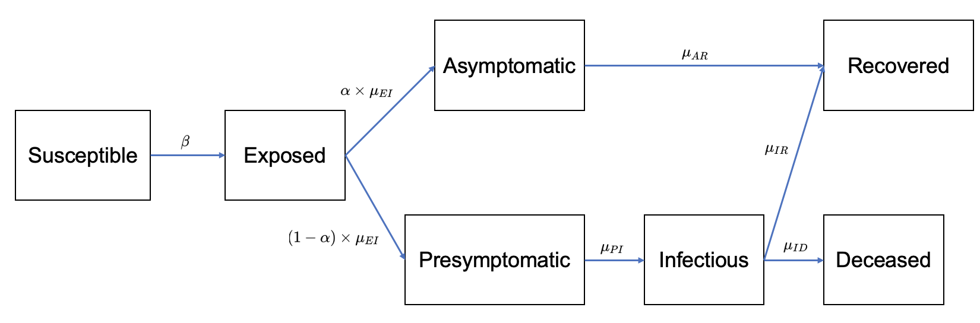
SEAPIRD model
More focused on after omicron cases, with a complicated framework

Slide 29
SEAPIRD model
Local search
coef. | β | μ_{IR} | μ_{ID} | μ_{EI} | α
value | 0.1515 | 8.000e-5 | 5.000e-6 | 0.8500 | 0.0866
coef. | μ_{AR} | μ_{PI} | ρ | N | τ
value | 0.1492 | 0.0140 | 0.9961 | 3.33e8 | 1000

Slide 30
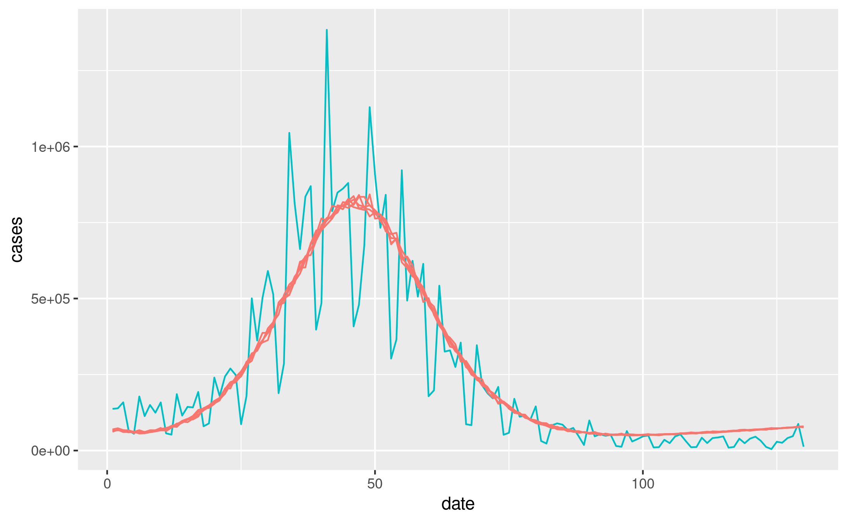
SEAPIRD model
Local search

Slide 31
SEAPIRD model
Global search
coef. | β | μ_{IR} | μ_{ID} | μ_{EI} | α
value | 0.1619 | 1.784e-4 | 1.672e-6 | 1.5506 | 0.0869
coef. | μ_{AR} | μ_{PI} | ρ | N | τ
value | 0.2562 | 0.0139 | 0.9990 | 3.33e8 | 1000

Slide 32
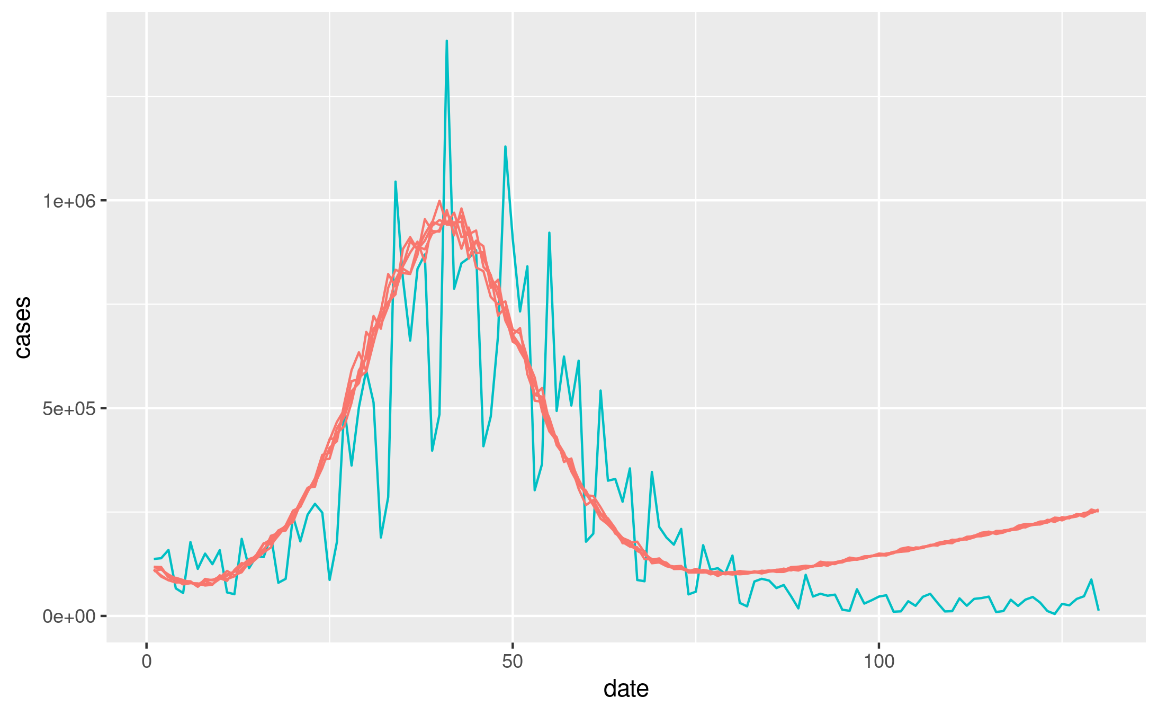
SEAPIRD model
Global search

Slide 33
Summary
SEAPIRD model is more similar to the real data
Short computation time & more accurate results with a shorter time interval

Slide 34
4. Conclusion

Slide 35
Conclusion
Applied models to real COVID19 data in the U.S.
SIR model with Bayesian method
SEIREIR model
SEAPIRD model
Considered the process of the model, computation time, and similarity between the simulation and the real world.
Continuous changes of β, N, γ are not reflected in the models
Coefficients in the models are lagging indicators. There will be a gap between the prediction and the actual covid19 progress.

